Slide 1
DCAF Debugging

Slide 2
Agenda
Basics RT Debugging
Debugging Reentrant Vis.
Running modules outside of the Engine.
Syslog
Tag View
CVT

Slide 3
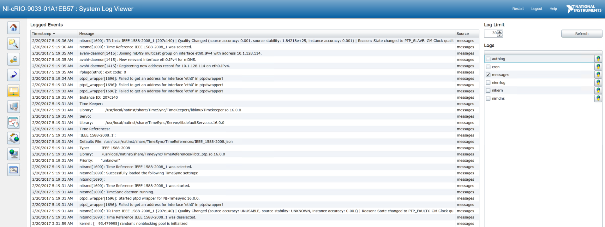
System Log View

Slide 4
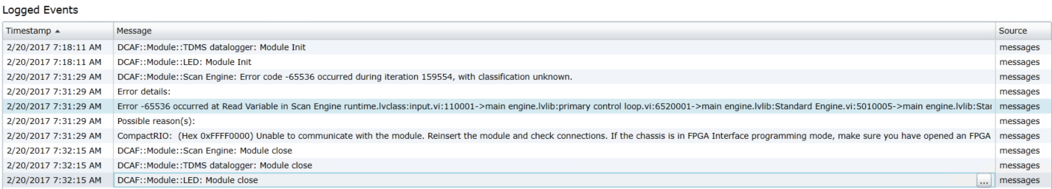
System Log View

